Slide 1
BookMyShow
Mini Project Presentation
Done By -
Abirami S
Akash A
Anuraag S
Ganesh Ram R
Rahul S

Slide 2
Project Goals
● Display the movies that can be booked
● Bulk discounts applied for group bookings
● Book a movie and return the e-Ticket

Slide 3
Key Points
Movie Management (MM) --- Uses REST APIs
Order Management (OM) --- Uses SOAP APIs
API Led Connectivity for designing the APIs
Secure the APIs with Client Id and Secret
Robust error handling and logging
CI/CD using Jenkins (if possible)

Slide 4

MOVIE Database

Slide 5
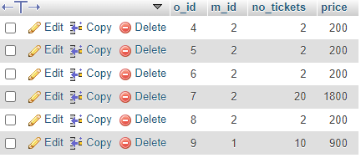
ORDER Database

Slide 6
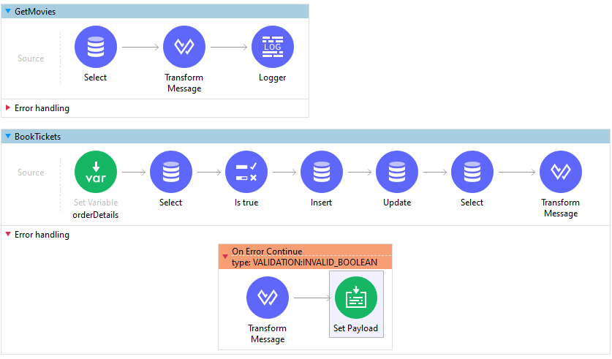
Implementation Flows

Slide 7
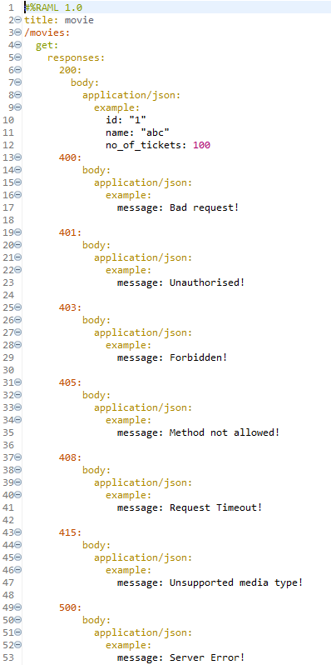
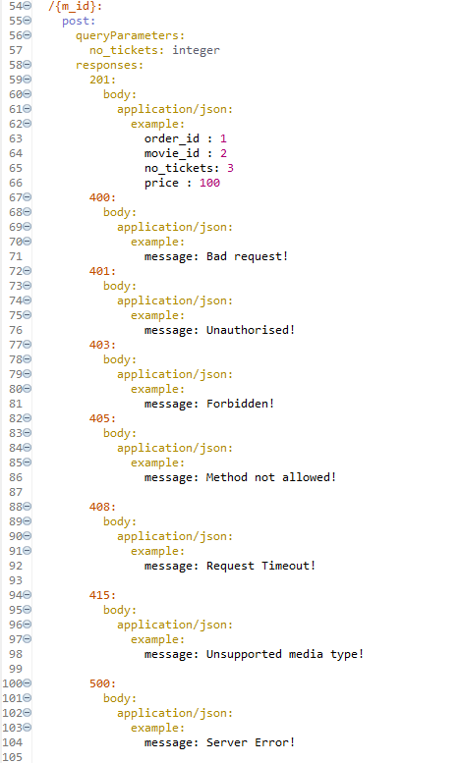
RAML SAMPLE
(BookMyShow API)

Slide 8
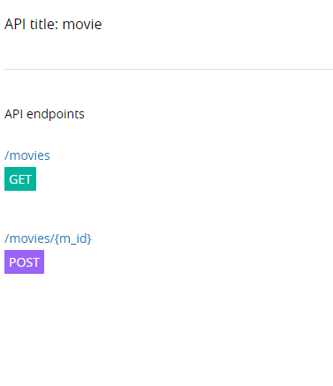
EndPoints
For BookMyShow API

Slide 9



CI/CD Implementation
New Push to GitHub Repository
Deployed to CloudHub
After Build
Jenkins Poll-SCM detects
Repo changes and Starts Build

Slide 10
Best Practices Adopted
Config properties in Mule Projects
Git (GitHub) for Managing Code
Build Automation using Jenkins
Client Id & Basic Auth Enforcement
API Auto-Discovery

Slide 11
Thank You

